Slide 1
AD privilege escalation workshop with Empire
A SEC565 Preview
© 2025 SANS Institute | All Rights Reserved

Slide 3
Environment Prep and Spinning up
Lab 1
Notes:
This area is intentionally left blank.

Slide 4
Intro to AD and Empire
© 2025 SANS Institute | All Rights Reserved

Slide 5
Intro to Active Directory
Most organizations leverage Active Directory (AD)
AD is a database used to manage Windows networks with
Resources: Computers, Users, Shares
Security Policies and Central Management: Group Policy
Access Rules that control relationships between resources: DACLs
"Active Directory enables centralized, secure management of an entire network, which might span a building, a city, or multiple locations throughout the world."
Notes:
Active Directory is a technology developed by Microsoft and included in professional versions of Windows.
Microsoft describes it as: "Active Directory enables centralized, secure management of an entire network, which might span a building, a city, or multiple locations throughout the world."
It is by far the most commonly used enterprise directory service.
Its built-in enterprise management tools render it a dream for both sysadmins and adversaries. Contrary to popular belief, AD is not limited to only Windows systems!
Active Directory started out as a directory service for Windows domains but has grown beyond domain, user, and computer management.
As a result, compromise of the Active Directory typically means a full compromise of the (majority of the) IT environment. The key Active Directory services we will focus on are security-related:
Resources: Computers, Users, Shares
Security Policies and Central Management: Group Policy
Access Rules that control relationships between resources: DACLs
References:
https://adsecurity.org/
https://attack.mitre.org/techniques/T1087/002/
https://attack.mitre.org/techniques/T1482/
https://attack.mitre.org/techniques/T1069/002/
https://learn.microsoft.com/en-us/previous-versions/windows/it-pro/windows-server-2003/cc780036(v=ws.10)

Slide 6
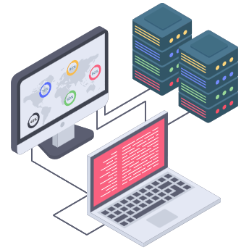
Why Should We Care about AD?
90-95% of fortune 1000 companies use AD or Azure AD
SME prefers AD as it reduces technical overhead
Facilitates management of their IT infrastructure
Not a lot of suitable alternatives out there
Notes:
According to Microsoft themselves, Active Directory is used by over 90% of fortune 1000 companies.
This is unsurprising, as the majority of users are used to Windows and is therefore a low barrier choice.
On top of that, there are not a lot of suitable alternatives out there to manage very big networks centrally.
As chances are great that the majority of your red team operations will involve Active Directory one way or another, the understanding of this technology will be crucial to achieving your objectives.
Reference:
http://download.microsoft.com/documents/uk/pcit/1-PCIT-Empowering%20People%20centric%20IT.pptx
Image reference:
https://www.flaticon.com/

Slide 7





Which Components Can Be Found in AD?
We already indicated that Active Directory is a database containing records for anything in the network ranging from computers to users to group policies. In order for AD to work efficiently, the architecture of AD consists of the following:
Schema: Contains definitions of every object that can be created in AD
Indexing and querying: Provides a mean to search specified records in the AD database
Global Catalog: Contains information about every object in a forest
Replication Service: The most interesting one for attackers—distributes information across domain controllers
Notes:
In order to understand Active Directory, we need to dissect the various components that are present.
Active Directory, at its core, is nothing more than a complex database containing anything in the network, including users, computers, groups, etc.
Active Directory contains the following components:
The Schema contains definitions of every object that can be created in AD.
As AD has to be able to manage big and complex networks, AD contains various optimization algorithms to perform indexing and querying objects.
The global catalog, which contains all information on Active Directory objects across a forest.
Finally, AD has replication services to make sure that all the managing nodes (Domain Controllers) have the most up-to-date data available to them.
Reference:
https://docs.microsoft.com/en-us/Windows-server/identity/ad-ds/get-started/virtual-dc/active-directory-domain-services-overview

Slide 8

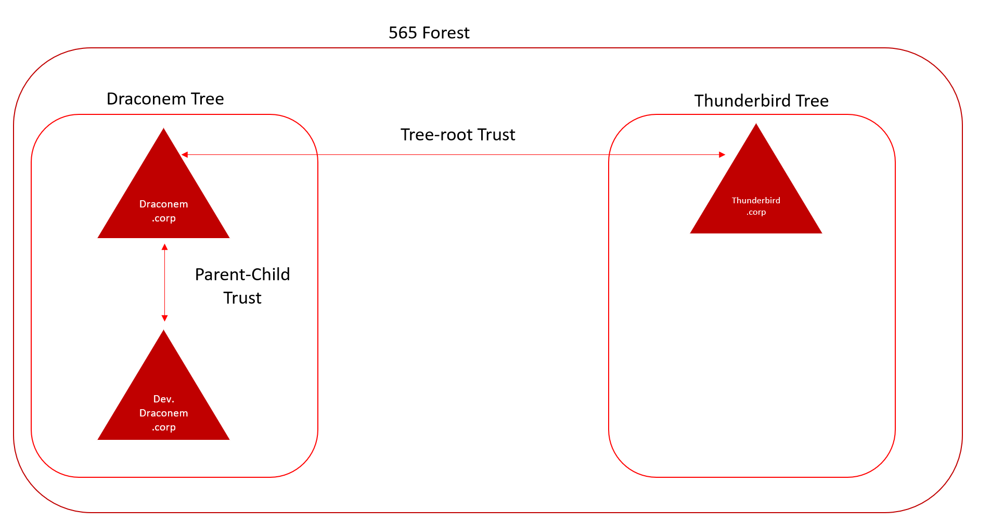
Trees & Forests
Microsoft domains are based upon the following core concepts:
Trees are collections of related domains
Forests are collections of trees that trust one another
According to Microsoft documentation, domains are not considered security boundaries, but forests are.
Trusts are used to allow authentication between multiple domains. By default, Microsoft creates the following trusts:
Parent-child trust (two-way, transitive) when a new domain is added in a tree
Tree-root trust (two-way, transitive) when a new tree is added in a forest
A variety of different trusts can be set up, depending on the specific use case.
"Domain Admins" are defined on a domain level (e.g., dev.draconem.corp)
"Enterprise Admins" are defined in the root domain at forest level (e.g., draconem.corp and thunderbird.corp)
Notes:
Let's shift our focus to the overall Microsoft domain and forest trusts. Microsoft domains are based on the following core concepts:
Trees are collections of related domains.
Forests are collections of trees that trust one another.
According to Microsoft documentation, domains are not considered security boundaries, but forests are.
Trusts are used to allow authentication between multiple domains. By default, Microsoft creates the following trusts:
Parent-child trust (two-way, transitive) when a new domain is added in a tree
Tree-root trust (two-way, transitive) when a new tree is added in a forest
A variety of different trusts can be set up, depending on the specific use case. We will discuss trust types in more detail later.

Slide 9
Example Trust Configuration
565 Forest
Draconem Tree
Thunderbird Tree
Tree-Root Trust
Draconem.corp
Thunderbird.corp
Parent-Child Trust
dev.draconem.corp
Once a trust is set up, the authentication flow is arranged. Permissions still need to be assigned, however! This is typically performed by adding remote users in local groups.
Notes:
The diagram on the slide provides an overview of what a typical domain/forest trust looks like:
We have a root domain, Draconem.corp, which has a child domain, dev.draconem.corp, in the same tree.
There is a parent-child trust between Draconem.corp and dev.draconem.corp.
We have another root domain, Thunderbird.corp.
There is a tree-root trust between Draconem.corp and Thunderbird.corp.
Once a trust is set up, the authentication flow is arranged. Permissions still need to be assigned, however! This is typically performed by adding remote users in local groups.
Default trusts are set up between root domains Draconem.corp and Thunderbird.corp (in the same forest). All of the trusts are two-way and transitive; hence, all domains trust one another in this setup.

Slide 10
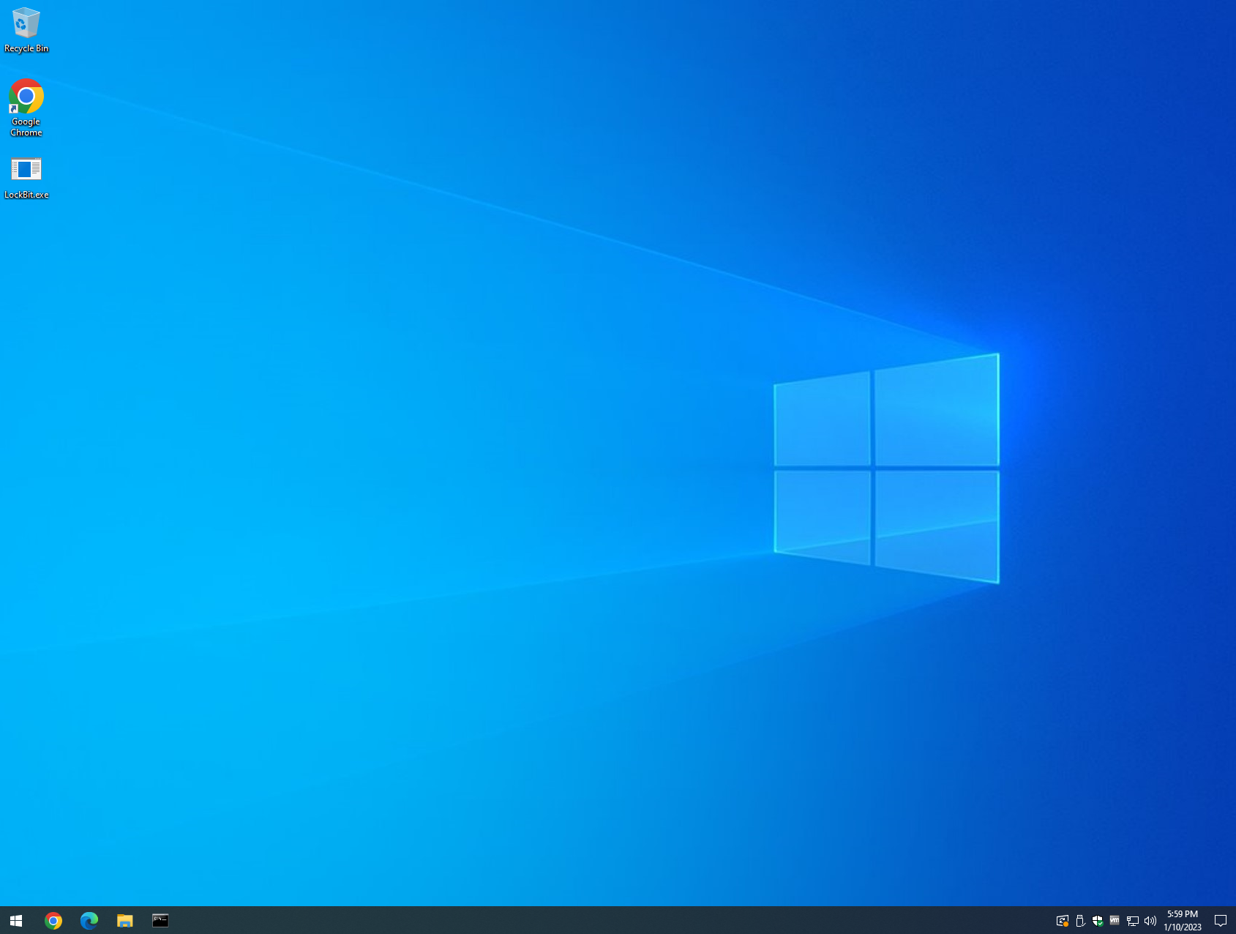
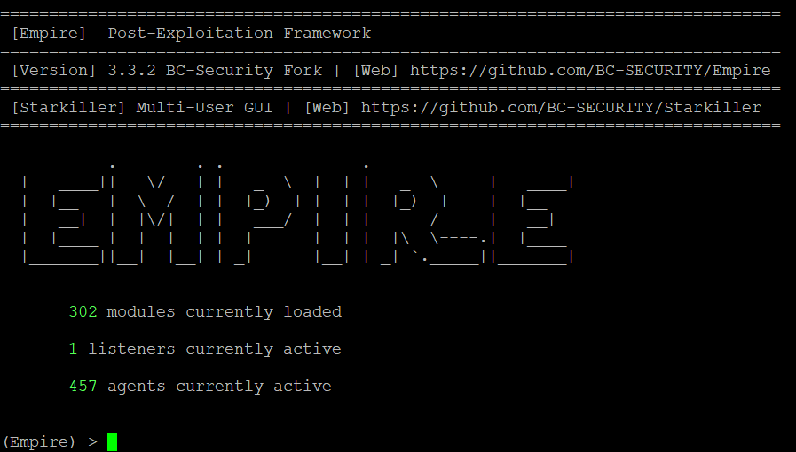
Command and Control
"Command and Control consists of techniques that adversaries may use to communicate with systems under their control within a victim network." - MITRE ATT&CK®
Target
C2 Server
Notes:
This module introduces some of the concepts around command and control. We want to gain and maintain control in the target environment.
Reference:
https://attack.mitre.org/tactics/TA0011/

Slide 11
C2 infrastructure
The objective for this module is to understand:
C2 Server
Listeners
Communication Channels
HTTP
DNS
Command and Control Tiers
C2 Client
Proxy Awareness
Sleep
Jitter
Notes:
The most fundamental aspect of a command-and-control framework is how the implants communicate with the C2 server. In a typical setup we will need a listener (an open port) that receives connections from the client (the implant). In most mature organizations, a company proxy might prevent establishing successful communications. As a result it is important to pick a C2 framework that is proxy aware.
In a mature red team, you typically don’t want to overextend your infrastructure into a single point of failure. This is why we segment red team infrastructure in different tiers based on functionality. More of this is covered in the various OPSEC modules in SEC565.

Slide 12
Listeners
A command and control (C2) server is an attacker-controlled system that is used to communicate with implants
C2 servers "listen," serve tasks, and retrieve the results from the registered implants
A variety of methods to establish network communications or "channels"
C3, or custom command and control, is used to identify bespoke implementations with the intention of avoiding detection of widely distributed tools
Notes:
A command and control (C2) server is an attacker-controlled system that is used to communicate with implants. These servers act as a command center by serving tasks and retrieving the results for the various implants deployed throughout the target space. Modern C2 servers use asynchronous communications in order to keep a lower network footprint and avoid detection.
There are a variety of C3, or custom command and control, frameworks and within each, a variety of methods to establish network communication or channels. We will discuss a few of those methods and focus on the more popular ones.
Reference:
https://attack.mitre.org/tactics/TA0011/

Slide 13
Communication Channels
The most popular C2 channels are:
HTTP/S (network egress)
DNS (network egress)
TCP (peer-to-peer)
SMB (peer-to-peer)
Some more esoteric examples are:
Gmail: https://github.com/byt3bl33d3r/gcat
Google Drive: https://github.com/lukebaggett/google_socks
Slack: https://github.com/Coalfire-Research/Slackor
Twitter: https://github.com/PaulSec/twittor
DNS-over-HTTP: https://github.com/sensepost/godoh
Notes:
Red teams may use a variety of methods to establish and maintain C2 communications. We will discuss the popular channels in further detail, but there are several creative techniques that are worth mentioning:
gcat: Developed by Marcello Salvati (@byt3bl33d3r), gcat is a Python-based backdoor that uses Gmail as a C2 server.
google_socks: Developed by Luke Baggett, google_socks is a script that allows two sockets to communicate while relaying data through Google Drive.
Slackor: Developed by Coalfire, Slackor is a Golang implant that uses Slack as a command and control channel.
Twittor: Developed by @PaulWebSec, Twittor is a Python backdoor that uses Twitter direct messages as a command and control server.
godoh: Developed by SensePost Command and Control framework, godoh is written in Golang and uses DNS-over-HTTPS as a transport medium.
References:
https://github.com/byt3bl33d3r/gcat
https://github.com/lukebaggett/google_socks
https://github.com/Coalfire-Research/Slackor
https://github.com/PaulSec/twittor
https://github.com/sensepost/godoh

Slide 14
Empire
Originally PowerShell Empire
Used as a POC to convince Microsoft PowerShell was not secure
Eventually, the dark side won! And Microsoft improved PowerShell security
Got picked up by our good friends over at BC Security – Shoutout to them!
Rebranded to just Empire
Multiple agents are developed, including exotic ones such as IronPython
Starkiller GUI
Open Source! Free! Still actively maintained! Well adopted!

Slide 15
Empire
Empire quick start guide:
Start ps-empire in a console
Wait until you see the starkiller web interface come up
Login to starkiller
Create a listener
Generate a stager (payload)
Get payload executed by victim (this is the hard part usually)
Interact with agent, enjoy a ton of built in postex modules!

Slide 16
Initial Empire Setup and Agent Callback
Lab 2
Notes:
This area is intentionally left blank.

Slide 17
Kerberos authentication
© 2025 SANS Institute | All Rights Reserved

Slide 18



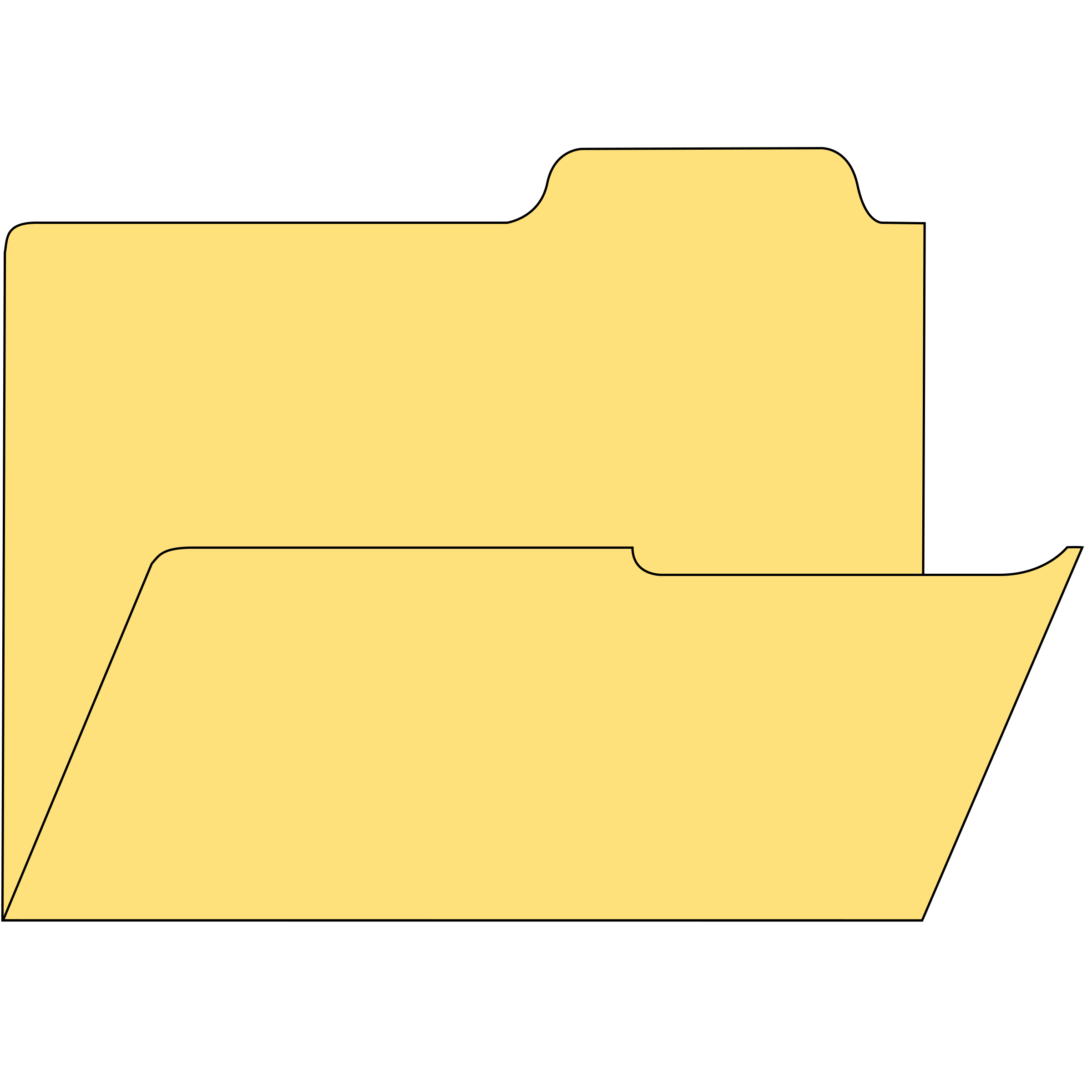
Kerberos Authentication
allan.marshall
Awesomesauce123
LSASS (kerberos.DLL)
1. AS-REQ
des_cbc_md5
a94a8fe5ccb19ba6
2. AS-REP
rc4_hmac_md5
d44d5e0591cb0f6ecb6d6a86ec9a12da
TGT
KDC
aes128_hmac
8451bb37aa6d7ce3d2a5c2d24d317af3
3. TGS-REQ
4. TGS-REP
aes256_hmac
f6e456436ef5d664290885dadfa879da 9e5caae0f8ceeae93305a4ae35c85d04
ST (TGS)
5. AP-REQ
File Server
The diagram on this slide provides an overview of how Kerberos works when the "rc4_hmac_md5" encryption type is used.
Notes:
Allan Marshal tries to authenticate to the system in this diagram—if you took 599/699, you will recognize this slide as we covered it there as well. It is important that you understand this flow, as this will be the foundation for understanding the different attacks we will discuss in a bit.
Allan tries to authenticate with the password Awesomesauce123—the SSP in lsass (kerberos.DLL) takes this input and calculates the Kerberos encryption key. This is based on the password.
Kerberos supports different kinds of encryption keys, such as DES, RC4, and AES.
Two important ticket types here: TGT and service tickets.
TGT is your passport—it proves you are who you say you are, and with your password, you can request STs. It is a bit like a theme park where the TGT would be your entrance ticket, and in the theme park, you need tickets to ride certain rollercoasters.
We call Kerberos a stateless protocol—why? Because it does not keep track of the state.
It does not keep track of AS REQ and AS REP.
What happens is that the TGT is proof that authentication has happened before. This is important to understand: the KDC only cares that you have a valid TGT in order to access further resources. It does not matter how you obtained said ticket.
You can compare that a bit with JWT for web applications.
Reference:
Illustration inspired by "Abusing Microsoft Kerberos - Sorry you guys don't get it," Benjamin Delpy (Blackhat USA 2014)!

Slide 19

Kerberos Authentication: Key Types
KDC long-term key (derived from "krbtgt" account password)
The KDC long-term secret key is the most important key of them all!
Used to encrypt the TGT (AS-REP) and sign the PAC (AS-REP and TGS-REP)
Client long-term key (derived from user account password)
The client long-term secret key is based on the computer or user account Used to check encrypted timestamp (AS-REQ) and encrypt session key (AS-REP)
Target long-term key (derived from service account password)
The client long-term secret key is based on the computer or service account Used to encrypt service portion of the ST (TGS-REP) and sign the PAC (TGS-REP)
Notes:
There are three main security keys used throughout the protocol:
The KDC long-term secret key, often called "domain key," is derived from the krbtgt service account. It is used in Kerberos to encrypt the TGT and sign the PAC.
The client long-term secret key, which is based on the password of the client account. It is used in Kerberos to check the encrypted timestamp (AS-REQ) and encrypt the session key.
The target long-term secret key, which is based on the password of the target service. It is used in Kerberos to encrypt the TGS and sign the PAC.
It should be clear that the compromise of any key represents a security risk. There is, however, one key that is more important than the others: if the KDC long-term secret key is compromised, adversaries can recreate TGTs and sign PACs, which would allow them to obtain all privileges within the domain.

Slide 20
Kerberos Authentication: AS-REQ
allan.marshall
Awesomesauce123
1. AS-REQ
2. AS-REP
rc4_hmac_md5
f56a8399599f1be040128b1dd9623c29
TGT
KDC
AS-REQ with pre-authentication (default in Windows)
User uses password (LT Key) to encrypt timestamp
Timestamp sent to the authentication server (AS) part of the Key Distribution Center (KDC)
KDC decrypts timestamp (has all LT keys in possession)
If decryption is successful, gives client a TGT (encrypted with target LT key and KDC long-term key)
3. TGS-REQ
4. TGS-REP
ST (TGS)
5. AP-REQ
File Server
Notes:
Let's have a look at the initial step here, AS-REQ!
AS-REQ: As an initial step, the client performs pre-authentication by sending an AS-REQ to the KDC (in this case, the AS component of the KDC). This AS-REQ includes an encrypted version of the timestamp (encrypted using the password hash of the client account), which is validated by the KDC. This "encrypted timestamp" is referred to as "pre-authentication" and is enabled (required) by default in Microsoft Kerberos environments.
AS-REP: If pre-authentication succeeds (timestamp can be decrypted), the KDC sends two items to the client:
The Ticket Granting Ticket (TGT), which includes the Client/TGS session key and is encrypted using the KDC long-term key (in the case of rc4_hmac_md5, the krbtgt NT password hash). This KDC long-term key is also used to sign the PAC (which is also part of the TGT and includes information on who the user is and what groups he is a member of);
The Client/TGS session key, encrypted using the client long-term key (in the case of rc4_hmac_md5, the user password hash).
It's interesting to note that when pre-authentication is not enabled, the KDC will provide an AS-REP response without validating the encrypted timestamp. While this is not a "critical" issue that would compromise the security of the Kerberos protocol (both response messages would still be encrypted with a key unavailable to the adversary), it would allow adversaries to launch brute-force attacks against the part of the response that is encrypted using the client long-term key (in case of rc4_hmac_md5, the user password hash). We will discuss this in a later module.
Reference:
Illustration inspired by "Abusing Microsoft Kerberos - Sorry you guys don't get it," Benjamin Delpy (Blackhat USA 2014)!

Slide 21


Kerberos Authentication: Ticket Granting Ticket
allan.marshall
Awesomesauce123
1. AS-REQ
2. AS-REP
rc4_hmac_md5
f56a8399599f1be040128b1dd9623c29
TGT
KDC
TGT - Encrypted using KDC LT key
3. TGS-REQ
Start / End / MaxRenew: 05/12/2018 07:12:18 ; 05/12/2018 17:12:18 ;
12/12/2018 07:12:18 ;
Service Name: krbtgt; synctechlabs.com
Target Name: krbtgt; synctechlabs.com
Client Name: alan.marshall; synctechlabs.com
Flags: 40e10000
Session Key: 0x00000012eb212eb23ca12eb23c 45eb4124af9010bf13f…<snip>
4. TGS-REP
Privilege Attribute Certificate (PAC)
Username: allan.marshall
SID: S-1-5-21-409 … <snip> Groups: Administrators … <snip>
ST (TGS)
Signed using Target LT Key
5. AP-REQ
Signed using KDC LT Key
File Server
Notes:
The TGT is the first ticket received by the client. What does it look like? The TGT includes the following information:
Name: This is the user's name the ticket is associated with.
Start time and end time: This marks the validity period of the ticket. By default, in Windows AD environments, this would be 10 hours.
Authorization data: Authorization data details the user's privileges and access rights. In Windows, the authorization data takes the form of a Privilege Attribute Certificate (PAC) object.
This is the Client/TGS session key that can be used for future communications between the client and the TGS.
Finally, to prevent the entire TGT from being tampered with, it is encrypted using the KDC long-term key (which is the krbtgt NT hash when rc4_hmac_md5 is used).
The TGT details cannot be read by the client, but that's fine as it only needs to send it back to the KDC for future validation (e.g., when a Service Ticket is requested).
In the TGS-REQ, the user wants to authenticate to a certain service and thus sends the following to the KDC (in this case, the TGS component of the KDC):
An authenticator message (encrypted using the Client/TGS session key)
The encrypted TGT and a ticket request (referencing a certain service principal name: SPN)
Reference:
Illustration inspired by "Abusing Microsoft Kerberos - Sorry you guys don't get it," Benjamin Delpy (Blackhat USA 2014)!

Slide 22
Kerberos Authentication: Service Ticket
allan.marshall
Awesomesauce123
1. AS-REQ
rc4_hmac_md5
f56a8399599f1be040128b1dd9623c29
2. AS-REP
TGT
Service Ticket (TGS)
KDC
3. TGS-REQ
Client Portion (encrypted using Client / TGS session key)
Validity time of the ticket
Session key
…
Server Portion (encrypted using Target LT key)
4. TGS-REP
ST (TGS)
Privilege Account Certificate (PAC)
Username: allan.marshall
SID: S-1-5-21-409 … <snip>
5. AP-REQ
Signed w Target LT Key
File Server
Signed w KDC LT Key
Notes:
If the KDC receives a TGS-REQ with a valid TGT, it will send back a response: TGS-REP. The KDC will validate whether the service to which the client requests access exists and subsequently create a service ticket (ST) that is sent back.
It does so by taking the PAC from the TGT, shoving it into an ST, and then signing that ST with the target LT key (password of the service) and the KDC LT (password of the krbtgt) and sending that ST to the user.
What happens if Allan requests an ST for a service he isn't allowed to access? Yep, the DC doesn't care. The target needs to handle authentication based on the PAC in the ST.
It's important to note that the KDC does not do any validation of privileges (the target service can do that by itself, by reviewing the PAC that is included in the service ticket; see below).
The service ticket has two parts:
A client portion, which is encrypted using the Client/TGS session key (so this can be decrypted by the client).
A server portion, which is encrypted using the target long-term key (in the case of rc4_hmac_md5, the password hash of the target service). This server portion also includes the PAC of the user. It is this service ticket that the user will subsequently submit to the service he or she is trying to access.
Reference:
Illustration inspired by "Abusing Microsoft Kerberos - Sorry you guys don't get it," Benjamin Delpy (Blackhat USA 2014)!

Slide 23
Kerberoasting and DCSyncing
© 2025 SANS Institute | All Rights Reserved

Slide 24
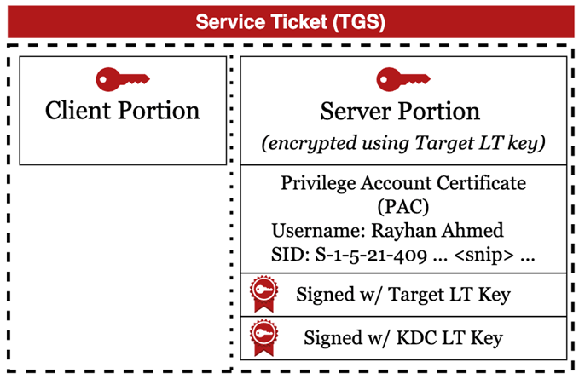
Kerberoasting
The server portion of a TGS is encrypted with the service's password, long-term (LT) key in a Kerberos supported encryption format
Any authenticated user can request service tickets (even if they are not allowed to use that service)
No interaction with service
TGS can be brute forced
Notes:
Discovered by Tim Medin from Red Siege and first presented at SANS HackFest, Kerberoasting leverages a flaw in Service Principal Names to obtain credentials from Active Directory service accounts.
Service Principal Names (SPNs) are used to identify each instance of a Windows service. To enable authentication, Kerberos requires that SPNs be associated with at least one service logon account. Any domain user can request a service ticket from the domain controller, as authorization needs to be handled by the target, not the domain controller. Since the server portion is encrypted with the target's long-term key, this ticket is susceptible to brute-force attacks.
References:
https://www.scythe.io/library/kerberoasting
https://attack.mitre.org/techniques/T1558/003/
https://github.com/SecureAuthCorp/impacket

Slide 25
Kerberoasting Tips and Tricks
Important to remember:
Invoking Kerberoasting functionality without additional parameters will result in Kerberoasting all susceptible accounts
Over roasting can trigger alerts ranging from RC4 requests to triggering honeypots/honey services
Be very picky about which accounts you wish to Kerberoast in a red team operation
Notes:
When using Kerberoasting tooling, the tool will typically attempt to request service tickets for all accounts. As we discussed, service accounts are often deployed with at least one honey service account that has been deployed to trap adversaries. From an OpSec perspective, it is not wise to let your tools run rampant. Remember your enumeration skills and be picky about which accounts you are going to Kerberoast. Prime targets are service accounts that have not had their password reset for a long time but are still actively being used in the environment (lastlogon property, logon count property). This will increase your chances of successfully performing the roast without triggering any alarms. As an additional reminder, by default, tooling will request tickets in the RC4 format. This makes the cracking significantly faster than the aes256 variant, but it comes at a price, especially in modern environments. RC4 is typically not being used in modern operating systems unless it is necessary; as a result, requesting multiple service tickets in the RC4 format can trigger anomaly alerts.

Slide 26
DCSync
Microsoft Directory Replication Service Remote Protocol (MS-DRSR) is the protocol used by domain controllers to replicate changes
Very important protocol to remain in sync
Requires Replicating Directory Changes All right
Usually granted to domain admins and domain controllers
Notes:
MS-DRSR, better known as the Microsoft Directory Replication Service Remote Protocol, is the protocol that is being leveraged between domain controllers to replicate changes. This is a very important protocol that all domain controllers use to remain in sync with each other. In order to perform this operation, we need to have the "Replicating Directory Changes All" right. These rights are typically only granted to domain administrators and domain controllers.

Slide 27
DCSync with Mimikatz
Mimikatz can perform the MS-DRSR RPC call and retrieve the user hashes stored on the domain controller using the lsadump::dcsync functionality.
C:\> Mimikatz.exe Mimikatz # lsadump::dcsync /domain:asgard.corp /user: ASGARD\krbtgt
SAM Username : krbtgt
Object Security ID : S-1-5-21-2716382980-2373322634-4127565559-502
Credentials:
Hash NTLM: d6a9e8d303d88aa310f95f14feac90b1
ntlm- 0: d6a9e8d303d88aa310f95f14feac90b1
lm - 0: ac092f5be282a6f104f0c5c0ecac51bd
Credentials
aes256_hmac (4096) : dd002d202266f9c5aa9beb5eaba6518dc57212b2a3e6ff7c2fbf3ded21259da1
aes128_hmac (4096) : ab5bc15c43d6055f90d6ce52f3de1400
des_cbc_md5 (4096) : 23762f45836b5219
Notes:
Mimikatz allows you to perform the MS-DRSR RPC call and retrieve the user hashes stored on the domain controller using the lsadump::dcsync functionality. You can either specify the /all flag to dump the entire AD or a specific user with the /user flag.
C:\> Mimikatz.exe Mimikatz # lsadump::dcsync /domain:asgard.corp /user: ASGARD\krbtgt
SAM Username : krbtgt
Object Security ID : S-1-5-21-2716382980-2373322634-4127565559-502
Credentials:
Hash NTLM: d6a9e8d303d88aa310f95f14feac90b1
ntlm- 0: d6a9e8d303d88aa310f95f14feac90b1
lm - 0: ac092f5be282a6f104f0c5c0ecac51bd
Credentials
aes256_hmac (4096) : dd002d202266f9c5aa9beb5eaba6518dc57212b2a3e6ff7c2fbf3ded21259da1
aes128_hmac (4096) : ab5bc15c43d6055f90d6ce52f3de1400
des_cbc_md5 (4096) : 23762f45836b5219

Slide 28
Kerberoasting, Lateral Movement and DCSYNC
Lab 3
Notes:
This area is intentionally left blank.

Slide 29
Hopping the Trust
After domain compromise, we can attempt to compromise other adjacent domains. We will cover:
Child to parent hop
Tree root "generic" hop (could potentially also be used in child parent hop)
Notes:
Once domain compromise has been achieved, the next step could be hopping trusts in order to compromise even more domains. The approach we can take for this varies from type of trust. In this course, we will cover two approaches:
Child to parent hop
Tree root "generic" hop (could potentially also be used in child-parent hop)
Reference:
https://web.archive.org/web/20210614030052/https://www.harmj0y.net/blog/redteaming/a-guide-to-attacking-domain-trusts/

Slide 30

Hopping the Trust: Parent/Child
Hop from a child to a parent DC
SID history
Facilitate the migration of users from one domain to another
User attempts to access a resource
Check current SID
Check SID history
Notes:
In order to understand how to hop from a child to a parent DC, we have to introduce a concept called SID history.
This was meant to facilitate the migration of users from one domain to another. If a user is migrated, their old security identifier (SID), along with the SIDs of any group they were previously a part of, can optionally be added to the sidHistory attribute of their new user account. When the new user attempts to access a resource, the authorization will take both the current SID and the SID that was set in the SID history into account!
Reference:
Image source: https://www.flaticon.com/

Slide 31
Adding Some History in Our Tickets
We have already identified that once we compromise the krbtgt:
We can forge our own TGTs and have full control over the PAC
We have full control over the SID history as well!
We can add optional SIDs to our user account and get those rights in the parent domain, too
This attack only works within a parent-child trust.
Notes:
We have already identified that once we compromise the krbtgt, we can force our own TGTs and have full control over the PAC. This means that we have full control over the SID history as well!
This means that we can add optional SIDs to our user account and get those rights in the parent domain, too.
This attack only works within a forest—it will not work cross-forest due to a mechanism called SID filtering, which will not allow SIDs of "privileged" groups to leave the forest boundary.

Slide 32
Golden Ticket
A golden ticket and a silver ticket are almost the same thing.
Instead of compromising the service, we need to compromise the krbtgt account of the domain
This will allow us to forge PACs within TGTs, giving anyone access to anything ☺
TGT - Encrypted using KDC LT key
Start / End / MaxRenew: 05/12/2018 07:12:18 ; 05/12/2018 17:12:18 ;
12/12/2018 07:12:18 ;
Service Name: krbTGT; synctechlabs.com
Target Name: krbTGT; synctechlabs.com
Client Name: alan.marshall; synctechlabs.com
Flags: 40e10000
Session Key: 0x00000012eb212eb23ca12eb23c 45eb4124af9010bf13f…<snip>
Privilege Account Certificate (PAC)
Username: alan.marshall
SID: S-1-5-21-409 … <snip> Groups: Administrators … <snip>
Signed using Target LT Key
Signed using KDC LT Key
Notes:
A golden ticket and a silver ticket are almost the same thing.
Instead of compromising the service, we need to have compromised the krbTGT account of the domain. Remember, in Kerberos authentication, TGTs are signed with the krbTGT long-term key. Compromising the krbTGT account means we can now forge our own PACs inside TGTs, allowing us to modify the PAC to access anything we want within that domain.

Slide 33

How to Execute SID History Attacks
Mimikatz can forge this golden trust (pun intended) ticket with:
The SID of the root domain
User to impersonate
Krbtgt hash of child domain
C:\> Mimikatz.exe kerberos::golden /user:DC01$ /domain:dev.asgard.corp /sid:S-1-5-21-2866327014-263153327-3370111089 /sids:S-1-5-21-2716382980-2373322634-4127565559-516,S-1-5-9 /krbtgt:e818c815dfa9a5f03cae9d1687d59e68 /ptt
Notes:
Mimikatz can forge this golden trust (pun intended) ticket, but we will need to know the SID of the root domain. We can identify this SID by enumerating the domain trust with PowerView, for example.
The SID of asgard.corp in our example is S-1-5-21-2716382980-2373322634-4127565559.
The SID of dev.asgard.corp in our example is S-1-5-21-2866327014-263153327-3370111089.
C:\> Mimikatz.exe kerberos::golden /user:DC01$ /domain:dev.asgard.corp /sid:S-1-5-21-2866327014-263153327-3370111089 /sids:S-1-5-21-2716382980-2373322634-4127565559-516,S-1-5-9 /krbtgt:e818c815dfa9a5f03cae9d1687d59e68 /ptt

Slide 34
Hopping the Trust: Parent/Child: C2s
Cobalt Strike have built-in golden ticket creation.
The bundled Mimikatz functionality allows to create the golden ticket.
Do it offline
Use the execute-Assembly or powershell-import task to run a newer version of Rubeus or Mimikatz.
Empire supports golden ticket creation natively with the powershell/credentials/Mimikatz/golden_ticket task.
Notes:
Cobalt Strike has built-in golden ticket creation functionality using Mimikatz. However, the safest way of creating the ticket would be to either do it offline or use the InlineExecute-Assembly Beacon object file to run Rubeus. Another alternative would be importing invoke-Rubeus using the powershell-import task.
Empire supports golden ticket creation natively with the "powershell/credentials/Mimikatz/golden_ticket" task.

Slide 35
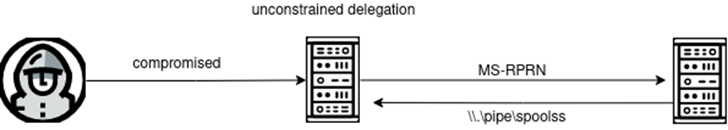
Hopping the Trust: Tree Root
Domain controllers are configured for unconstrained delegation.
Required for DC functionality
Unconstrained delegation should ring a bell
Coerce authentication cross trust means compromising cross trust
Same attack scenario as "normal" constrained delegation
Notes:
The fun thing about domain controllers is that they are configured for unconstrained delegation. This is intended and is not something that can be "turned off," as the domain controller needs this functionality to function properly.
Unconstrained delegation should already ring a bell, as we have covered earlier. Coercing an authentication back to us cross-forest means compromising the cross-forest trust.
This is true for tree-root, but also for parent-child domains. In this case we will not need to add any extra SIDs as we would effectively force a machine cross trust to authenticate to us and steal its TGT.

Slide 36
Delegation
Kerberos delegation is a Kerberos feature that allows services to execute actions on behalf of authenticated users.
There are three types of delegations:
Unconstrained
Constrained
Resource-based constrained
Notes:
Kerberos delegation is a Kerberos feature that allows services to execute actions on behalf of authenticated users (impersonation). A common example to explain the need for delegation is front-end servers (e.g., web servers) that need to interact with back-end servers (e.g., database servers) on a client's behalf.
There are three types of delegations:
Unconstrained: The most legacy of them all and very unsafe.
Constrained: Potentially safe, but potentially even worse than unconstrained, depending on configuration.
Resource-based constraints: The safest option.
We will discuss all of them in this module!
References:
https://web.archive.org/web/20220209070550/http://www.harmj0y.net/blog/activedirectory/s4u2pwnage/
https://shenaniganslabs.io/2019/01/28/Wagging-the-Dog.html
https://shenaniganslabs.io/2019/08/08/Workshop-Slides.html

Slide 37
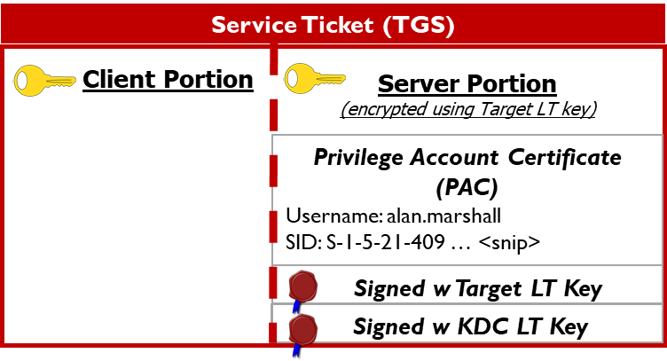
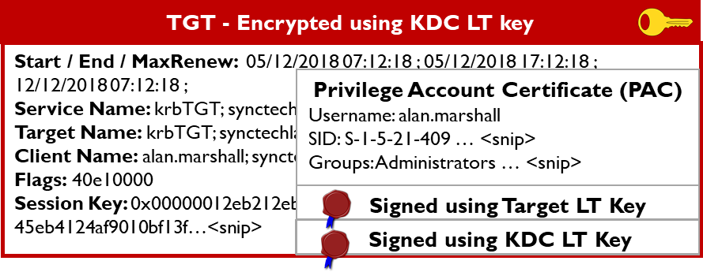
Unconstrained Delegation
Unconstrained delegation replaces the PAC in a TGS with a full TGT. What could go wrong? ☺
Notes:
Microsoft launched an unconstrained delegation to solve the problem that is often referred to as the "double-hop" issue.
If a user authenticates to Machine A and that machine needs to "relay" that authentication to another machine, Machine A will need to have some sort of mechanism to convey the credentials of the originating user.
The way Microsoft designed the "fix" to the problem with unconstrained delegation is by replacing TGS PACs with the TGT of the originating user for all systems that are configured as unconstrained delegation systems.
This means that Machine A now has the full TGT of the user and can thus use that user's TGT to relay to any additional machine.
References:
https://docs.microsoft.com/en-us/defender-for-identity/cas-isp-unconstrained-kerberos
https://adsecurity.org/?p=1667

Slide 38
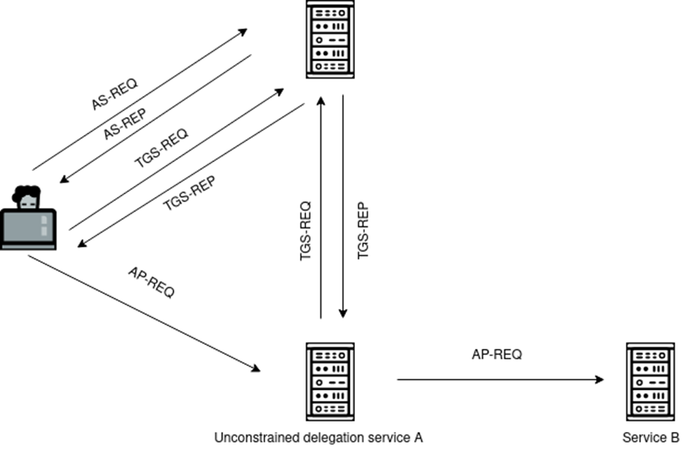
Unconstrained Delegation Flow
Notes:
Let's take a look at how unconstrained delegation authentication flows over the AD environment:
User is going to pre-authenticate as usual (AS-REQ, AS-REP), which is going to give the user his/her TGT.
The user wants to access Service A, so the user is going to ask the KDC to give out a service ticket for that service using his/her TGT (TGS-REQ), which the domain controller will do without batting an eye (TGS-REP).
The user will now authenticate to Service A with the service ticket (AP-REQ). The service ticket the user has received looks different than a normal service ticket, though, because Service A is configured for unconstrained delegation. This means that the TGS for Service A will actually contain the TGT of the user.
Service A authorizes the user to authenticate to itself and is now going to request, using the user's TGT, a TGS (TGS-REQ) for Service B, effectively fully impersonating the original user.
The DC complies (TGS-REP). Now, Service A can authenticate to Service B on behalf of the original requestor (AP-REQ).

Slide 39
Recognizing Unconstrained Delegation
We can find unconstrained delegation computers using PowerView, SharpView, or if you are brave enough, LDAP.
#LDAP
PS C:\>([adsisearcher]'(&(objectcategory=computer)((userAccountControl:
1.2.840.113556.1.4.803:=524288)))').FindAll().GetDirectoryEntry() | Select-Object -Property *
#PowerView
PS C:\> Get-DomainComputer -Unconstrained
#SharpView
PS C:\> Get-DomainComputer -Unconstrained
Notes:
We can find unconstrained delegation systems by querying the computer objects in AD. We will introduce an additional flag in our search query called the userAccountControl. These values are described on the MSDN. The value for unconstrained delegation is 524288.
The results of this search will always have the domain controller in there, as domain controllers are required to have unconstrained delegation, or they won't work (useful to know for later in this section).
PS C:\>([adsisearcher]'(&(objectcategory=computer)((userAccountControl:
1.2.840.113556.1.4.803:=524288)))').FindAll().GetDirectoryEntry() | Select-Object -Property *
#PowerView
PS C:\> Get-DomainComputer -Unconstrained
#SharpView
PS C:\> Get-DomainComputer -Unconstrained
Reference:
http://www.selfadsi.org/ads-attributes/user-userAccountControl.htm

Slide 40
Forceful Authentication
What if we can force connections to a controlled unconstrained delegation system?
Notes:
If we can compromise a computer with unconstrained delegation, we, therefore, compromise all users that have their TGT cached on the system.
If we are lucky, there are some high privileged users that have authenticated to the system. But would it not be cool if we could "force" interesting accounts to authenticate to us?
As it turns out, we can do just that.

Slide 41

PrintSpooler
Print system remote protocol (MS-RPRN)
Allows for arbitrary forced authentication
Microsoft claimed this as a "won't fix" issue
Notes:
At DerbyCon 2018, Lee Christensen, Will Schroeder, and Matt Nelson presented their findings on research they conducted with regard to security descriptors.
Part of that research identified a "won't fix" security vulnerability ("feature," according to Microsoft), where any authenticated user could trigger an RPC call to remote systems.
This RPC call belongs to the MS-RPRN (Print System Remote Protocol). By making the RPC call, it is possible to force a system to authenticate back to an arbitrary system over SMB.
As you can imagine, this is a disaster if an attacker has control over an unconstrained delegation system, as we can harvest TGTs of these machines that have been forced to authenticate to us.
Reference:
https://www.slideshare.net/harmj0y/derbycon-the-unintended-risks-of-trusting-active-directory

Slide 42
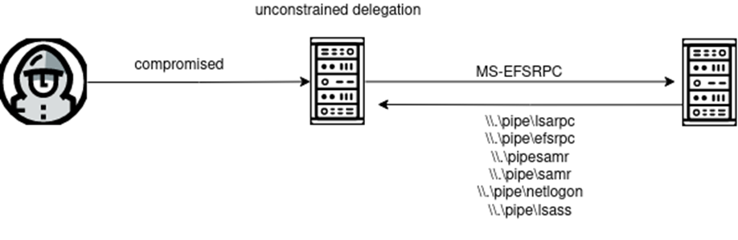
PetitPotam
Gilles Lionel rocked the infosec world on July 18, 2021.
MS-EFSRPC allows for arbitrary authentication
Unauthenticated initially (patched)
Still works authenticated
Notes:
Much like the folks of SpecterOps did in 2018, a researcher called Gilles Lionel surprised the infosec world with another way of forcing authentication to an arbitrary machine.
This time, it was not the printer RPC call but the encrypting file system remote protocol (MS-EFSRPC). With PetitPotam, it is possible to send a multitude of API calls to a system, which will trigger an authentication back.
The finding was even worse than the printer finding of SpecterOps, as initially, it was possible to use PetitPotam from a completely unauthenticated point of view.
Microsoft realized this was a major issue and released a patch that got rid of the unauthenticated vulnerability and one of the API calls. Unfortunately, to this day, it is still possible to trigger PetitPotam from an authenticated perspective, even on the most up-to-date systems.
The only defense that completely mitigates the risk is either implementing RPC filtering or blocking the RPC calls in the firewall.
References:
https://github.com/topotam/PetitPotam
https://twitter.com/gentilkiwi/status/1421949715986403329

Slide 43
Unconstrained Delegation + Forced Authentication
You can compromise any system vulnerable to coerced authentication once you compromised an unconstrained delegation system.
Compromise a system configured for unconstrained delegation
Force a connection with SpoolSample/PetitPotam
Listen for incoming TGTs using Rubeus
Harvest the tickets, pass them in your session
Notes:
We have already discussed that if a machine is configured for unconstrained delegation, the TGTs will get cached inside the server's memory. If we combine this knowledge with Print Spooler or PetitPotam, we are able to abuse this functionality to force domain controllers (or other interesting assets) to connect to us.
Afterward, we can harvest their TGTs, effectively compromising them.

Slide 44
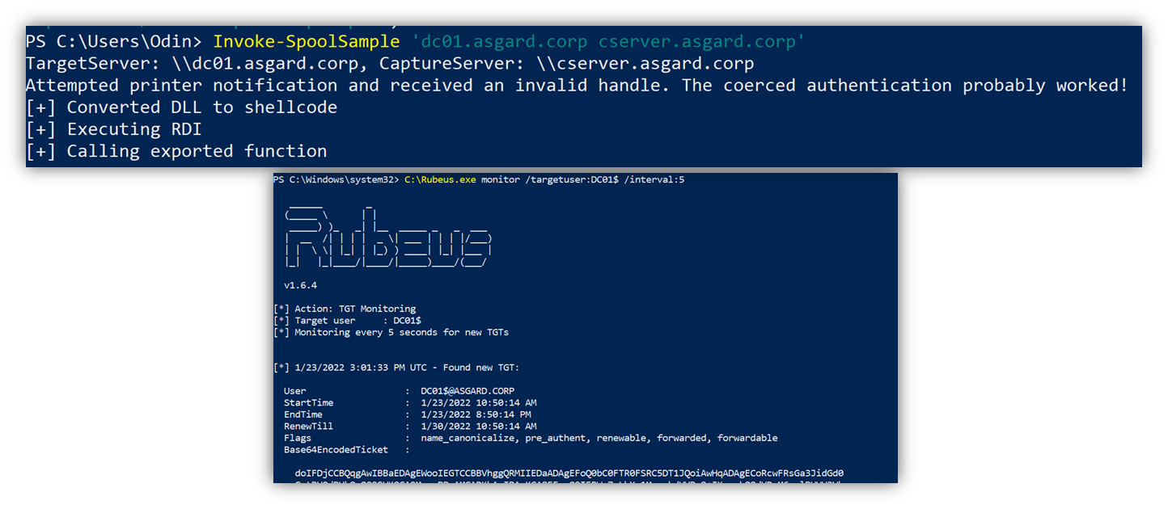
Rubeus for Unconstrained Delegation Abuse
Notes:
Using Rubeus on a system with unconstrained delegation in high integrity, we can monitor for new incoming TGTs and harvest them straight from memory.
Combined with PetitPotam or SpoolSample, this is deadly as it leads to full domain compromise.
PS C:\ Invoke-SpoolSample "dc01.asgard.corp cserver.asgard.corp"
PS C:\Rubeus.exe monitor /targetuser:DC01$ /interval:5

Slide 45

Unconstrained Delegation and Empire
Empire has no support for running tasks like this in the background.
Agent crashes when Rubeus is monitoring
Unfeasible to conduct attack over Empire
Can be "bypassed" by spawning alternative C2 channel
Notes:
Empire has no support for running tasks like this in the background. As a result, executing unconstrained delegation attacks from Empire is unfeasible. The command will simply hang your agent indefinitely, making you lose your valuable implant in the network.
The only workaround would be using the /runfor switch in Rubeus and piping the output of Rubeus to a file. This would touch disk and is not very OpSec-safe.

Slide 46
Hopping Trusts
Lab 4
Notes:
This area is intentionally left blank.

Slide 47
Thank you and hopefully see you again soon!
Perhaps in SEC565? ☺
© 2025 SANS Institute | All Rights Reserved

Slide 48
Contacts and Resources
AUTHOR
OFFENSIVE OPERATIONS RESOURCES
Jean-François Maes
Dave Mayer
https://www.sans.org/offensive-operations/
@SANSOffensive
@Jean_Maes_1994
@dmay3r
Notes:
Jean-François Maes
Jean-François is based in Portugal where he is the European director of advanced assessment for Neuvik, specializing in internal penetration testing as well as red teaming and adversary emulation and simulation.
Prior to Neuvik, Jean-Francois worked for other noteworthy firms, including, but not limited to, TrustedSec, Fortra's Cobalt-Strike team, and NVISO.
He is a strong believer in open source and an avid contributor to the offensive security community. Jean-François is currently teaching SANS course SEC699: Advanced Purple Teaming - Adversary Emulation & Detection Engineering and is the lead author of SEC565: Red Team Operations and Adversary Emulation.
David Mayer
Dave is the Managing Director of Advanced Assessments and CIO for Neuvik. Previously, Dave was a member of Citibank's Red Team, leading Adversary Emulations and Red Team engagements. After his time at Citibank, he was the Red Team Director for numerous well-respected consulting firms conducting Red Teaming, Purple Teaming, Adversary Emulations, and penetration testing. Dave holds a Bachelor of Science from SUNY- Plattsburgh and several certifications, including GIAC GSE, GSEC, GSNA, GCIA, GCFE, GPEN, GXPN, GCIH, GWAPT, GAWN, and OSCP.

